Slide 1



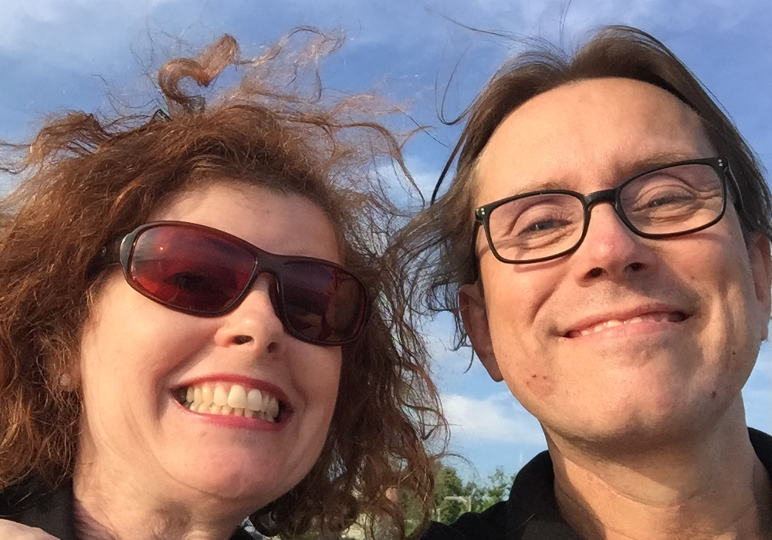
Denise Humphrey & Thorsten Butz
Oh, I'm an Alien
Avoiding the hidden traps of training delivery in foreign languages
Notes:
Description
Most of us MCTs deliver training in either foreign languages and/or foreign countries. English is for many trainers their primary second language – except for those native speakers who frequently deliver their ‘know how’ in foreign countries. We are all part of the ‘global instructor scene’. This workshop is about those things that you never dared to ask and the many things that you are not aware of.
http://mctsummit.eu/wp-content/uploads/2016/10/MCTSUMMIT-17-THESSALONIKI.jpg

Slide 2
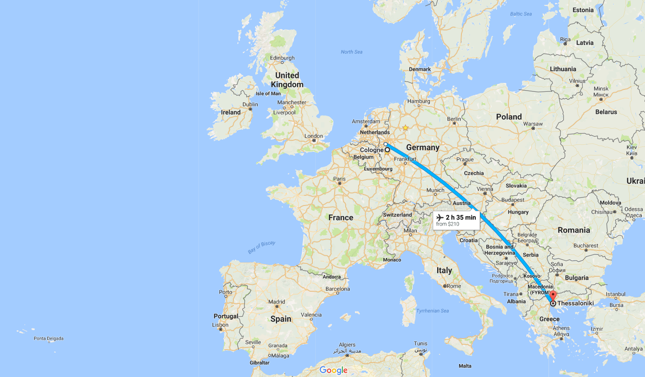
about_speakers
Denise en-GB, tea
Thorsten de-DE, coffee

Slide 3








Efcharistoume our sponsors

Slide 4
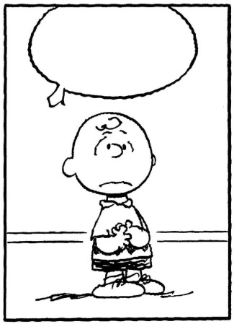
Why?
Notes:
About motivation
Over a few drinks in a bar in Cologne and after some intense conversation, it was clear to us that there are some clear differences in the way people feel about certain words. The way you address people makes a difference to how people treat you in return. Your choice of words and gestures can even affect the overall evaluation of your training. We thought that this might be of interest to you guys as most of use deliver training in other countries.

Slide 5
Ignorance is bliss
Fraternisation
Colloquial vs. gutter language
Educational systems, marks and graduations
Acceptable speech/Joking Gender, sexual orientation, (ethnic) roots, …
Blasphemy
Notes:
During this presentation we will have some fun (hopefully) with various words and gestures. Ignorance is bliss of course, but after this session we hope to have at least made you think a little about how important this is and to help you avoid falling into these hidden traps when training in countries where you are less familiar with the culture and what is acceptable language to use in the 'classroom'.

Slide 6
Agenda
In/formal addressing t-v distinction
School grades From 0 to hero
The Don’ts Parental advisory

Slide 7
Chapter 1: the t-v distinction
Latin: tu / vos
French: tu /vous
Spanish: tú / usted
Italian: tu /Lei
Portugese: tu / você …
German: du / Sie
Dutch: je,jij / U
Danish: du / De
Finnish: sinä / Te …
Notes:
https://sites.google.com/site/tvdistinction/home/introduction
Are you aware of the Tu – Vous distinction? Does your country have one?
I personally train quite often in Germany and Switzerland - luckily it's always in English. But that doesn’t mean I won’t fall into any traps as a word that has no offence to me, may have offence for others.
Even though I am aware for example that in Germany you are expected to address a person as Frau or Herr until they 'invite' you to use their first name, I always introduce myself as Denise. Does this mean that I'm open for a drink after training? I find this very hard as the English language doesn’t have this distinction. For me the du and Sie is a bit tricky.

Slide 8
Common Misunderstandings
“Thou comest in such a questionable shape”
William Shakespeare: Hamlet (ca. 1600)
Notes:
https://sites.google.com/site/tvdistinction/home/introduction
Brief summary:
Just out of interest, during the lifetime of Shakespeare, English did provide a "t-v" distinction. They used 'thou' and 'you'. Do you know which would have been formal and wich informal?
"thou" represents the informal, familiar address in contrast to "you", the formal style which later on derived as the general purpose pronoun.

Slide 9










Liberté, égalité, fraternité
?
Strict use of "v"
1960s
Du-reformen
Time
Notes:
https://en.wikipedia.org/wiki/Libert%C3%A9,_%C3%A9galit%C3%A9,_fraternit%C3%A9-
Late 1960s:
https://en.wikipedia.org/wiki/Du-reformen
Do you agree with this graph in which at the top of the list of importance of the Tu-Vous where France is at the top and Sweden at the bottom?
Btw: In 1967 Sweden switched from left to right driving:
https://en.wikipedia.org/wiki/Dagen_H

Slide 10
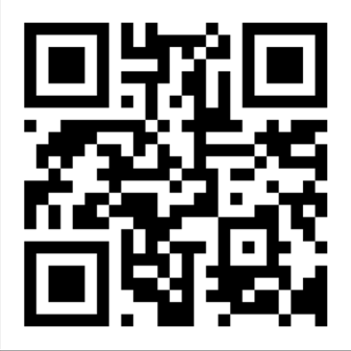
Vote now! http://etc.ch/5FqX
Which country (language) does use the strictest distinction of formal addressing from your experience/opinion ?
RESULT: https://directpoll.com/r?XDbzPBd3ixYqg8kXI04YoJO41aGvRcAgTvZmBrBs
Notes:
http://directpoll.com

Slide 11


Wassup, Donald?
Notes:
https://upload.wikimedia.org/wikipedia/commons/5/56/Donald_Trump_official_portrait.jpg

Slide 12
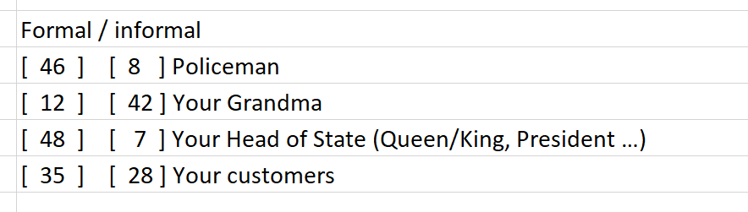
Your mileage varied

Slide 13
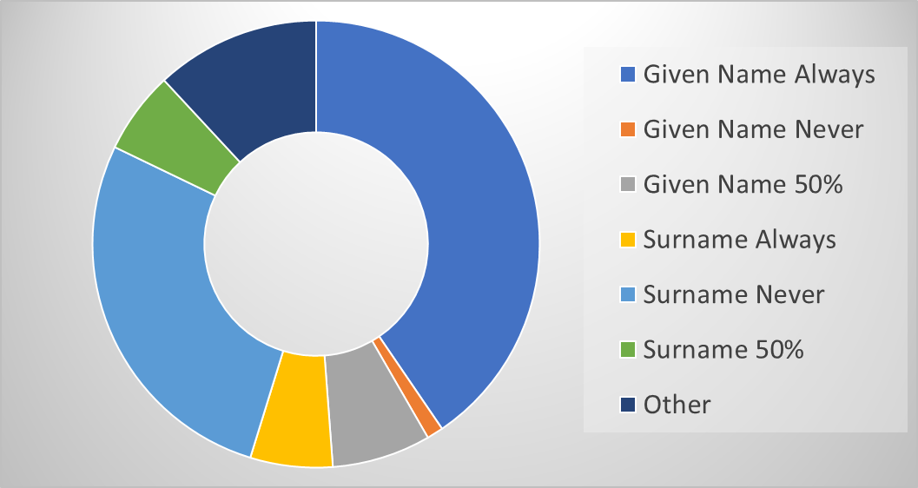
How do people address you in the ‘classroom’?
Notes:
Given Name 50% represents when people have said they do either

Slide 14
Resumee, Chapter 1
The absence of distinct rules of formal addressing, does not make it "easy" adjust your "tone".

Slide 15
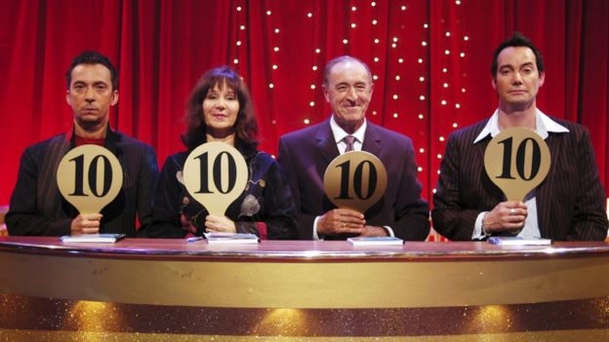
Chapter 2: Scoring
Notes:
https://ichef-1.bbci.co.uk/news/624/cpsprodpb/234D/production/_90373090_strictlyoriginals.jpg

Slide 16
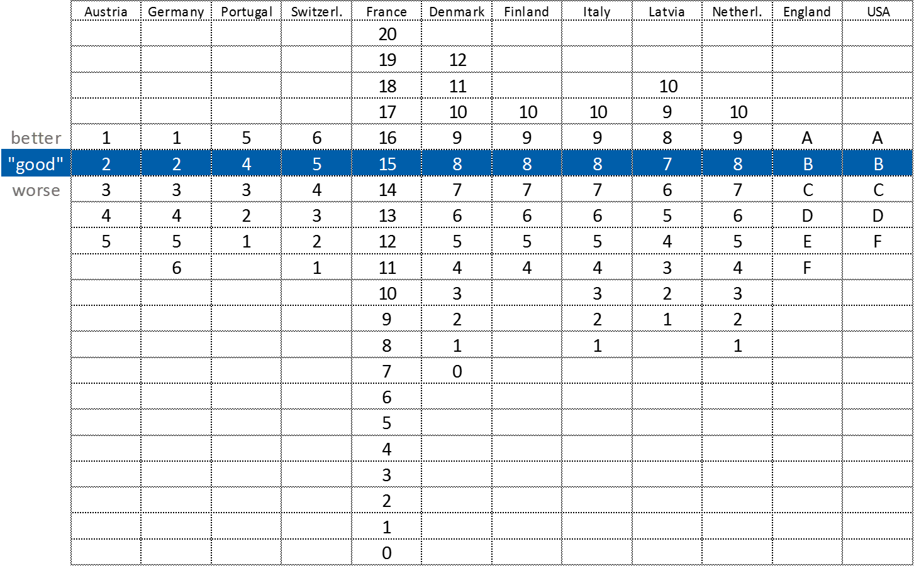
School grades

Slide 17
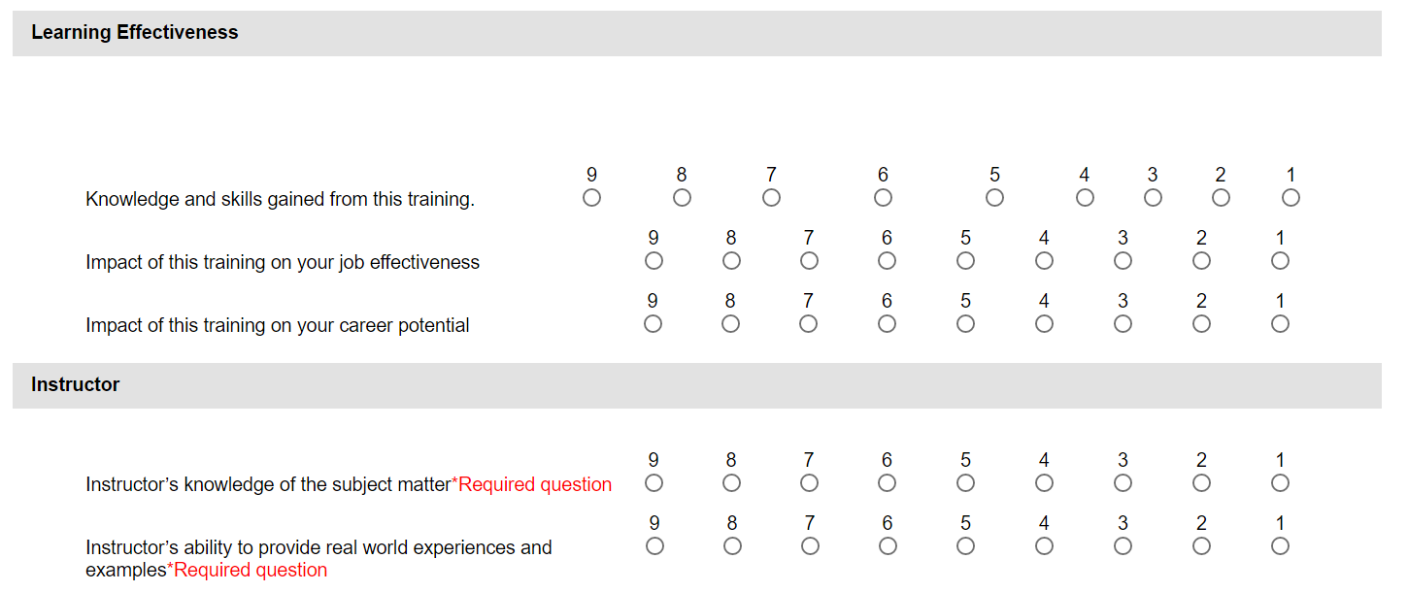
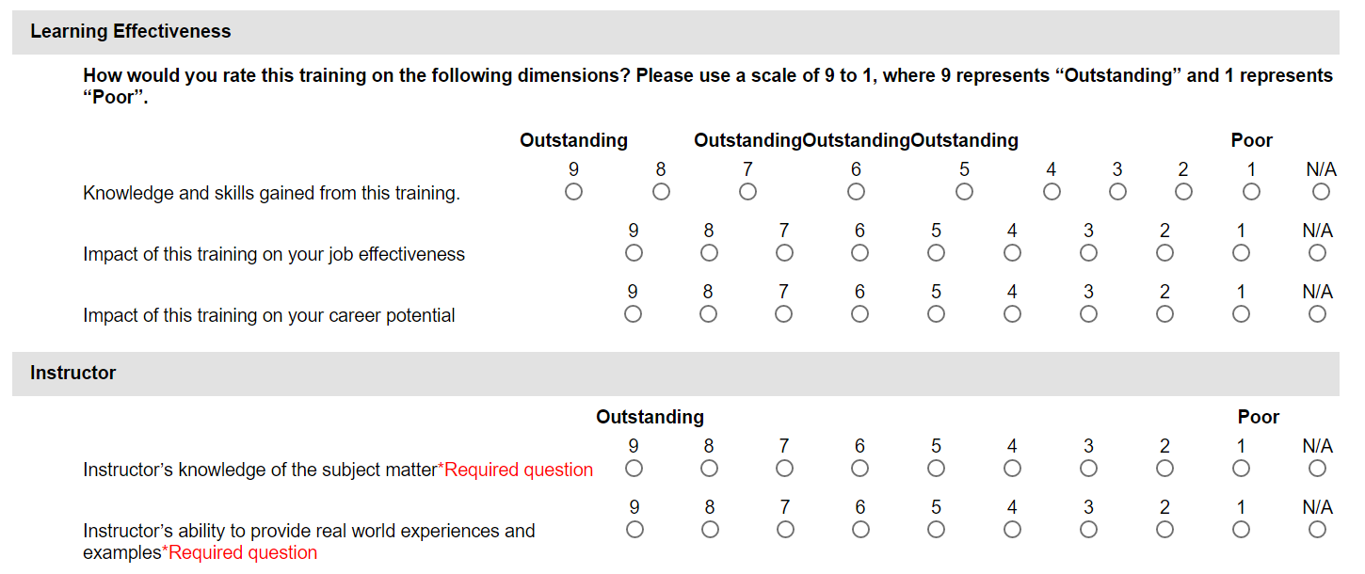
MTM
Notes:
Compared to the anglo saxon grades, there is not connotation or sublimal meaning in it.

Slide 18
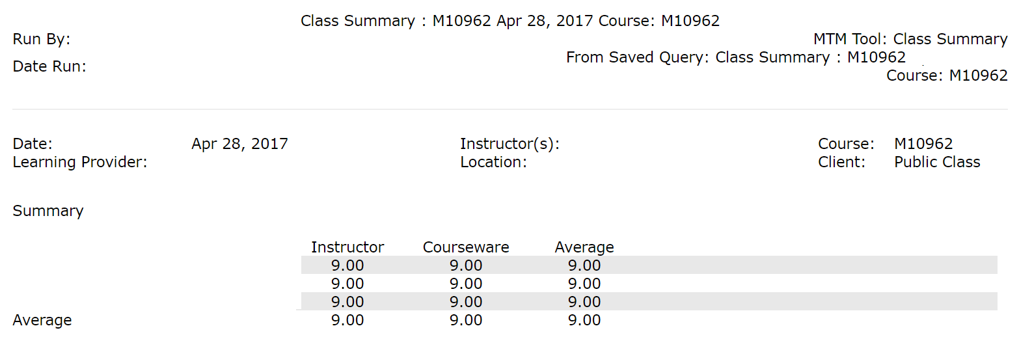
How was it for you, darling?

Slide 19
What's YOUR feeling about grade 2?
Moderate
Almost fail
Familiar Damm Fear Terrible Low F*ck
Can’t remember
Kinder garden
Better than OK - nearly
Harsh
Good Annoying Disappointing
Cute Degrading
Awesome!!!
Grades are stupid
Better than average
Failure
Nostalgic
Unsatisfactory – failed exam
Still happy about School Inferior Bad Poor Rubbish
Investigate & evolve
Elementary

Slide 20
Resumee, Chapter 2
Marks are numbers charged with social and cultural hidden meanings.

Slide 21
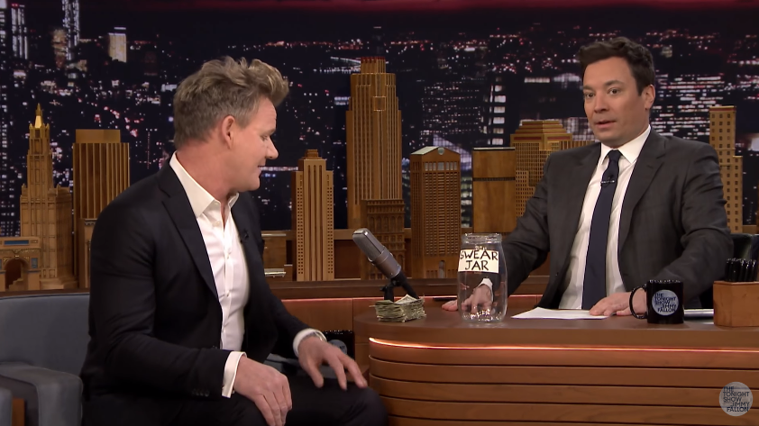
Chapter 3: The don'ts
Notes:
https://www.youtube.com/watch?v=wkSYGykMiwE
https://vimeo.com/209069504/2523944e15

Slide 22



Vote!
Which of the upcoming phrases would you use "on stage"?

Slide 23

[01]
I do like this sexy new feature
in OneDrive, formally known
as placeholders.

Slide 24
[02]
You should stop fucking around
with the click UI and start
learning PowerShell.

Slide 25
[03]
I noticed that UK customers don't
care a shit about Hyper-V.

Slide 26
[04]
Start teaching Sharepoint was the
stupidest career decision ever.

Slide 27
[05]
No enterprise agreement ?
You're kidding me, aren't ye?

Slide 28
[06]
Keep in mind: you have to work
with this crap 'til you're 64!

Slide 29
[07]
Hell freezes over: Windows on Git!

Slide 30
[08]
I hate it to my guts when
the demo breaks.

Slide 31
[09]
How the heck could I ever have
lived without this awesome new Azure RM template!

Slide 32
[10]
For Christ‘s sake, you should never
delay those security updates.

Slide 33
[11]
Sorry for the delay, that gpu driver
pissed me off 10 seconds before the presentation.

Slide 34
[12]
Horrible implementation.
Without a doubt.

Slide 35

Shit, Shitless, Crap,
F*ck, F*cking,
Boll*cks, Arse/Ass,
Hell, Christ, Jesus,
Balls, C*nt, Cock,
Piss, B*stard
*Denise can‘t bear to see these on screen
Sexy,
Feck**
**only ok in Ireland ;)
Stupidest, Kidding,
Freaking, Heck, Hate (better to say dislike),
Guts
Notes:
https://en.wikipedia.org/wiki/Seven_dirty_words
shit, piss, fuck, cunt, cocksucker, motherfucker, and tits
http://www.bbfc.co.uk/what-classification/r18

Slide 36
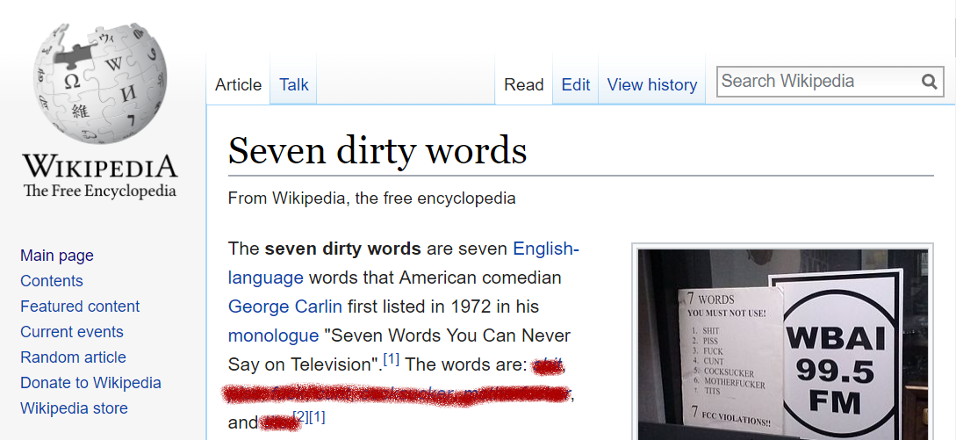
Resumee, Chapter 3
Check your luggage.
https://en.wikipedia.org/wiki/Seven_dirty_words

Slide 37
"One cannot not communicate."
Paul Watzlawick

Slide 38
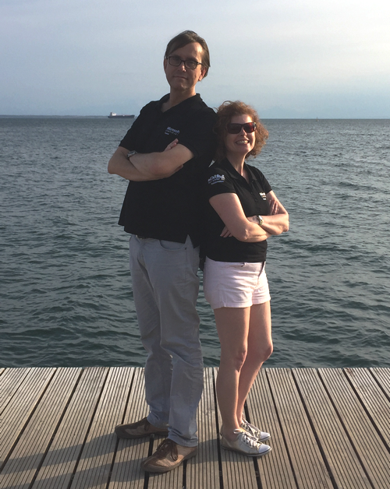

KEEP
CALM
AND
ENJOY
#MCTSUMMIT
Corbel 57, 28

Slide 39

Efcharistoume our sponsors

Slide 40
Extra content & deleted slides

Slide 41
Bonus movie: Jimmy Fallon: Dr. W.
Notes:
https://www.youtube.com/watch?v=H7wm1v7bm2M

Slide 42
"We're disappointed too. With consternation.
We see the curtain closed the plot unended"
Bertold Brecht, 1940

Slide 43
"It's not easy having a good time!"
Dr. Frank N. Furter, 1975

